Slide 1
Random Variables

Slide 2
Random Variables
For a given experiment, a random variable is a function that maps every outcome in the sample space to a real number
Consider last four transactions in a bank with G denoting genuine transactions and F denoting fraudulent transactions
Our sample space will be: S = {GGGG, GGGF, GGFG, …, FFFF}
We can summarize this to a real number set: S = {0, 1, 2, 3, 4}
So now:
p(X = 2) is the probability that F = 2
p(X >= 2) is the probability that F is at least 2
p(X < 2) is the probability that F < 2
Number of fraudulent transactions

Slide 3
Random Variable
A random variable is a variable whose value depends on the outcome of a random event
There are two types of random variables: discrete random variables and continuous random variables
Discrete random variables take on a finite or countably infinite number of distinct values, while continuous random variables can take on any value within a specified range

Slide 4
Random Variables
A discrete random variable is a variable that can only take on discrete values.
Credit ratings: AAA, AA, B, BBB, etc
Number of orders received on a shopping website
Customer churn: 0 is no churn, 1 is churn
A continuous random variable, on the other hand, can take on any value in a certain interval.
Market share of a company (Infinite possible values between 0% and 100%)
Time taken to place an online order
Waiting time at an ATM

Slide 5
Probability Distributions

Slide 6
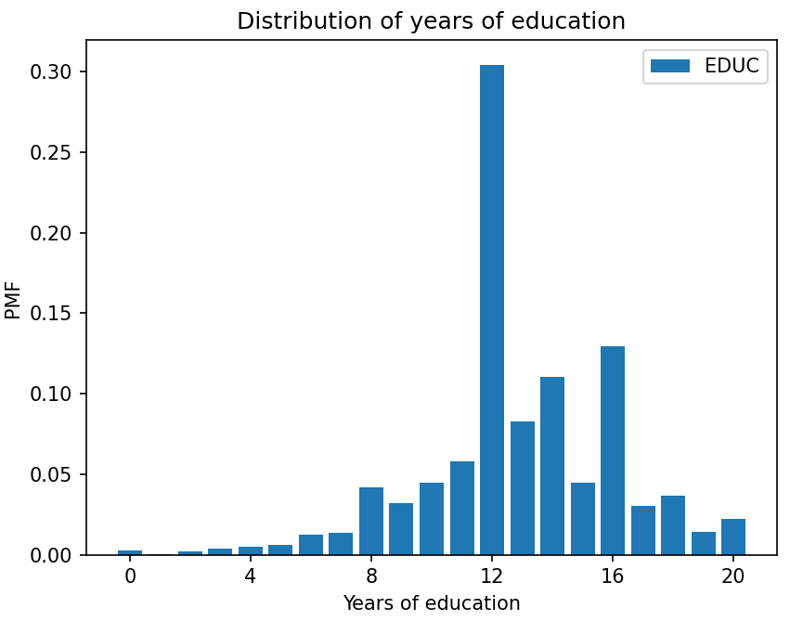
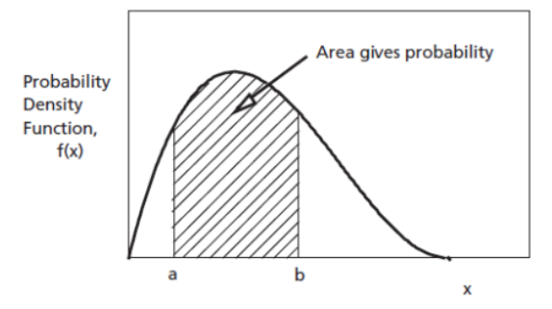
Distribution
Distribution: Describes all the probable outcomes of a variable
Discrete distribution: Sum of all individual probabilities must equal 1
Continuous distribution: Area under the probability curve equals 1

Slide 7
PMF, PCF, PDF

Slide 8
What are PMF, PDF, CDF?
Probability Mass Function (PMF): Describes the probability of a discrete random variable taking on a specific value rather than falling within a range of values
Probability Density Function (PDF): Describes the probability of a continuous random variable taking on a value within a certain range of values
Cumulative Distribution Function (CDF): Describes the probability that a random variable (continuous or discrete) will take on a value less than or equal to a certain value

Slide 9
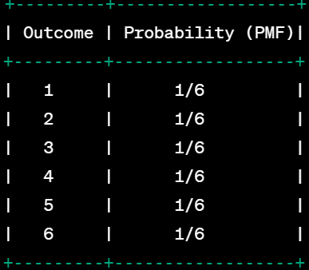
Probability Mass Function (PMF)
The Probability Mass Function (PMF) is denoted by P(X = x), where X is the random variable and x is a possible value that X can take
It is used for discrete data
Example: Throw a fair dice

Slide 10
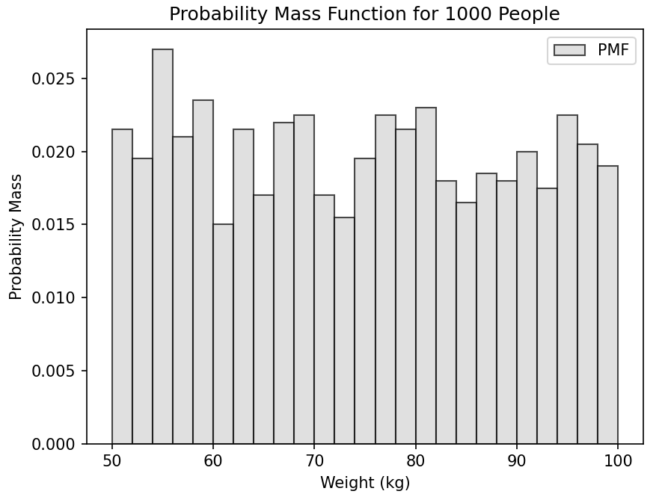
PMF for Weight of People

Slide 11
Code
import numpy as np
import matplotlib.pyplot as plt
# Generate random weight data for 1000 people between 50 and 100 kg
np.random.seed(42) # Set seed for reproducibility
weights = np.random.uniform(50, 100, 1000)
# Plotting the histogram as the PMF
plt.hist(weights, bins=np.arange(50, 101, 2), color='lightgray', edgecolor='black', alpha=0.7, label='PMF', density=True)
plt.xlabel('Weight (kg)')
plt.ylabel('Probability Mass')
plt.title('Probability Mass Function for 1000 People')
plt.legend()
# Show the plot
plt.show()

Slide 12
Probability Density Function (PDF)
A Probability Density Function (PDF) describes the probability distribution of a continuous random variable
It is the probability that the variable is equal to a specific value or in a range of values
Suppose we record heights of people in inches
Question: What is the probability that the height of a randomly selected person is between 60 and 65 inches?
PDF will not give the exact probability at a specific height, e.g. 63.5 inches, but it will give it for a range (say 60-65 inches)

Slide 13
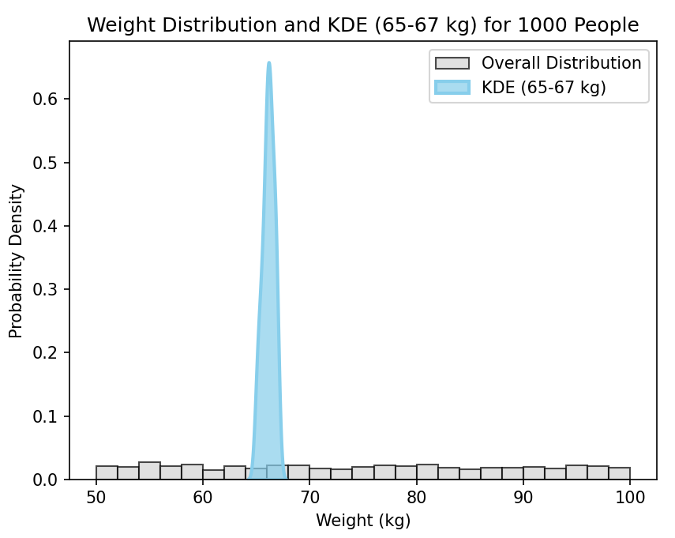
PDF for Weight of People

Slide 14
Code
import numpy as np
import seaborn as sns
import matplotlib.pyplot as plt
# Generate random weight data for 1000 people between 50 and 100 kg
np.random.seed(42) # Set seed for reproducibility
weights = np.random.uniform(50, 100, 1000)
# Filter weights within the range 65-67 kg for KDE visualization
weights_kde_range = weights[(weights >= 65) & (weights <= 67)]
# Plotting the histogram for the entire weight range with density parameter
plt.hist(weights, bins=np.arange(50, 101, 2), color='lightgray', edgecolor='black', alpha=0.7, label='Overall Distribution', density=True)
# Plotting the KDE (PDF) for the weight data in the specified range with common_norm
sns.kdeplot(weights_kde_range, bw_method=0.5, fill=True, color='skyblue', alpha=0.7, linewidth=2, label='KDE (65-67 kg)', common_norm=False)
plt.xlabel('Weight (kg)')
plt.ylabel('Probability Density')
plt.title('Weight Distribution and KDE (65-67 kg) for 1000 People')
plt.legend()
# Show the plot
plt.show()

Slide 15
Cumulative Distribution Function (CDF)
The Cumulative Distribution Function (CDF) of a random variable X is the sum of probabilities up to some value.
Example: Suppose we have the following PMF for a football match
P(0) = 0.1 (probability of not scoring any goals)
P(1) = 0.2 (probability of scoring exactly 1 goal)
P(2) = 0.3 (probability of scoring exactly 2 goals)
P(3) = 0.2 (probability of scoring exactly 3 goals)
P(4) = 0.1 (probability of scoring exactly 4 goals)
P(5) = 0.05 (probability of scoring exactly 5 goals)
P(6) = 0.05 (probability of scoring exactly 6 goals)

Slide 16
Cumulative Distribution Function (CDF)
Then the CDF will be:
F(0) = P(X ≤ 0) = 0.1
F(1) = P(X ≤ 1) = 0.1 + 0.2 = 0.3
F(2) = P(X ≤ 2) = 0.3 + 0.3 = 0.6
F(3) = P(X ≤ 3) = 0.6 + 0.2 = 0.8
F(4) = P(X ≤ 4) = 0.8 + 0.1 = 0.9
F(5) = P(X ≤ 5) = 0.9 + 0.05 = 0.95
F(6) = P(X ≤ 6) = 0.95 + 0.05 = 1

Slide 17
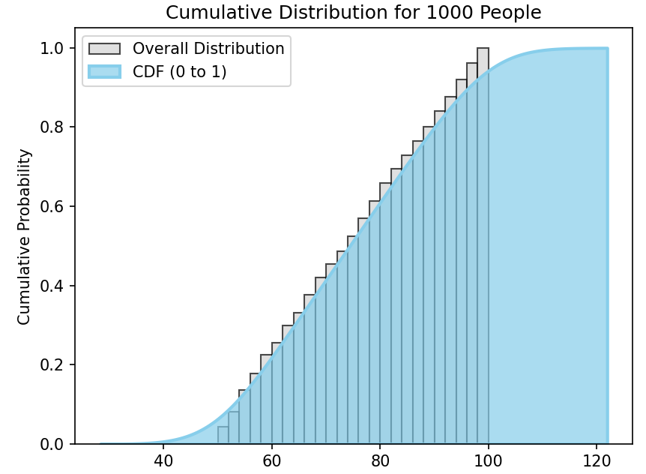
CDF Example for Weight

